Slide 1
EASTERN RELIGIONS SLIDES
sample slides from the
robinest.org collection

Slide 2
about these slides:
The twenty slides here are from our extensive and growing collection of slides for teaching eastern religious traditions. Feel free to use these slides in your teaching. Instructors who assign our eBooks as their course text will have access to the full collection of slides and to our other teaching resources.
For more information, visit
www.robinest.org.
Slides for western religions are also available.
© Copyright:
These slides are copyrighted and cannot be distributed beyond use in your classroom. Note that certain images have additional copyrights, as indicated on the slides.
We welcome comments and suggestions: (robinson@robinest.org).
If you find these slides useful, please tell other instructors about our resources.

Slide 3
Terminology
River
I
N
D
U
S
Country
I
N
D
I
A
Person
H
I
N
D
U
Language
H
I
N
D
I
Religion
H
I
N
D
U
I
S
M

Slide 4
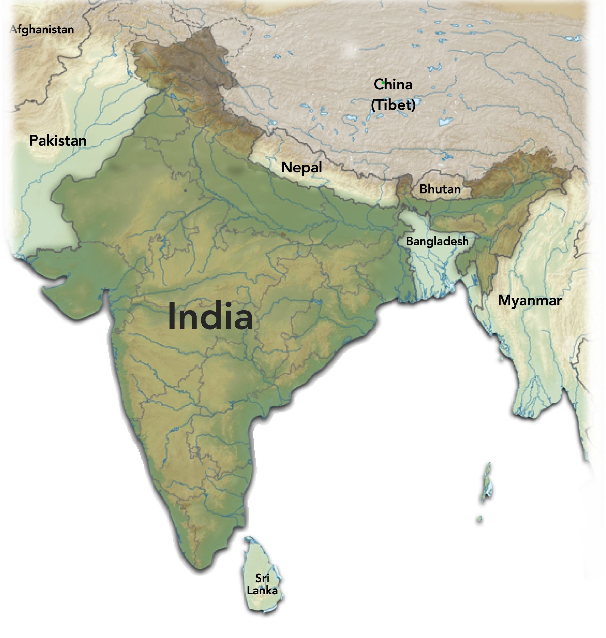
India and Her Neighbors
India and her Neighbors
A
Hindu
Buddhist
Muslim

Slide 5
The Hindu Class System
Twice Born
Notes:
+

Slide 6
Cosmic Time
Mahayuga:
1 Mahayuga =
(4,320,000
human years)
Treta-yuga
Kalpa:
1000 Mahayugas =
1 Kalpa (Day of Brahma)
(4,320,000,000
human years)
Mahayuga
Life of Brahman:
36,000 Kalpas =
1 Life of Brahma)
1 Life of Brahma =
(311,040,000,000,000
human years)
Dvapara-yuga
Satya-yuga
Kali-yuga
Notes:
+

Slide 7
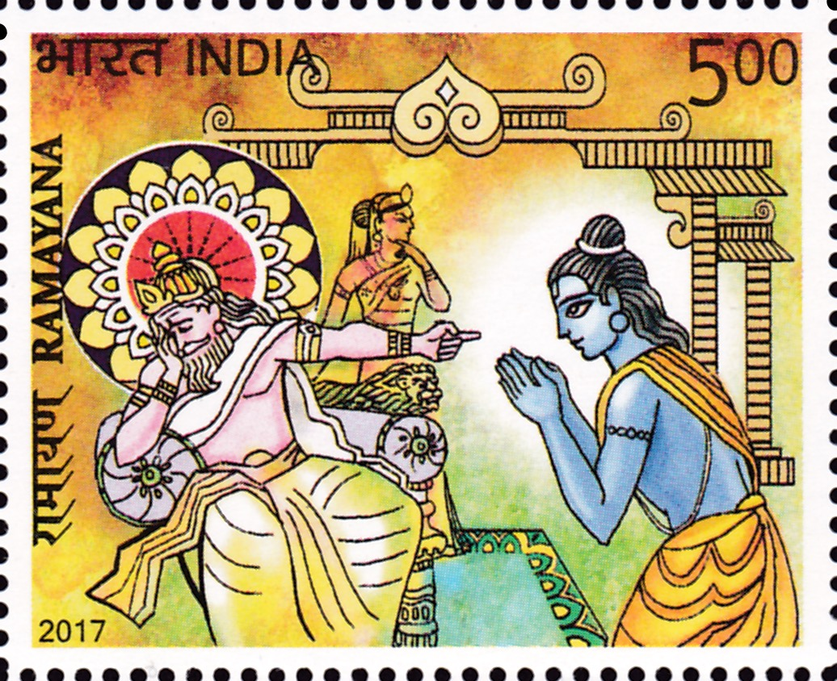
Ramayana
Rama’s father is distraught as he exiles his son to the forest for fourteen years.

Slide 8
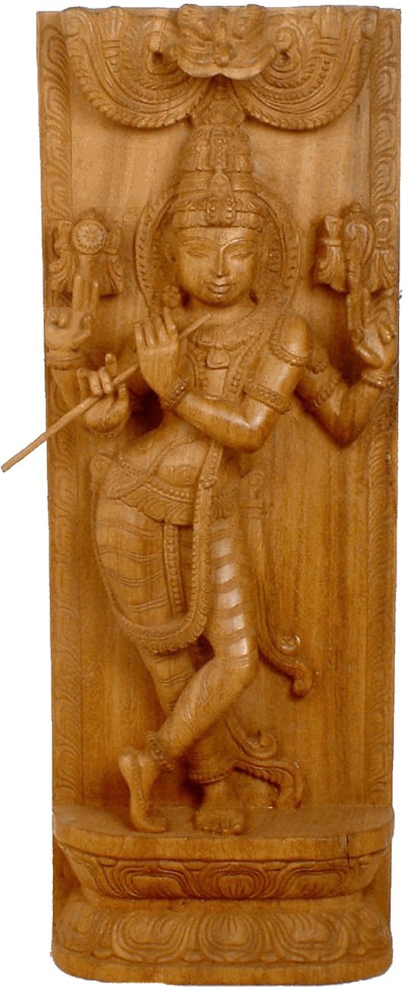
The Krishna Avatara
One of Vishnu’s most beloved avataras, Krishna’s best-known myths are as a flute-playing cowherd and as kingly advisor in the Bhagavad Gita.
Image from exoticindia.com

Slide 9
Main Religions of India

Slide 10
The Four Noble Truths
2
3
4
1
The Noble
8-Fold Path
Origin / Cause
End of Dukkha
Suffering /
Dukkha
diagnosis
(ignorance)
remedy
(nirvana)
prescription
symptoms

Slide 11
The Noble Eight-fold Path
Proper
Viewpoint
Proper
Contemplation
Proper
Intention
Proper
Mindfulness
Proper
Communication
Proper
Perseverance
Proper
Action
Proper
Livelihood

Slide 12
Wheel of Life
Old Age / Death
Ignorance
Birth
Karmic dispositions
Becoming
Consciousness
Grasping
Name and Form
Thirst
Six Senses
Sensation
Contact

Slide 13
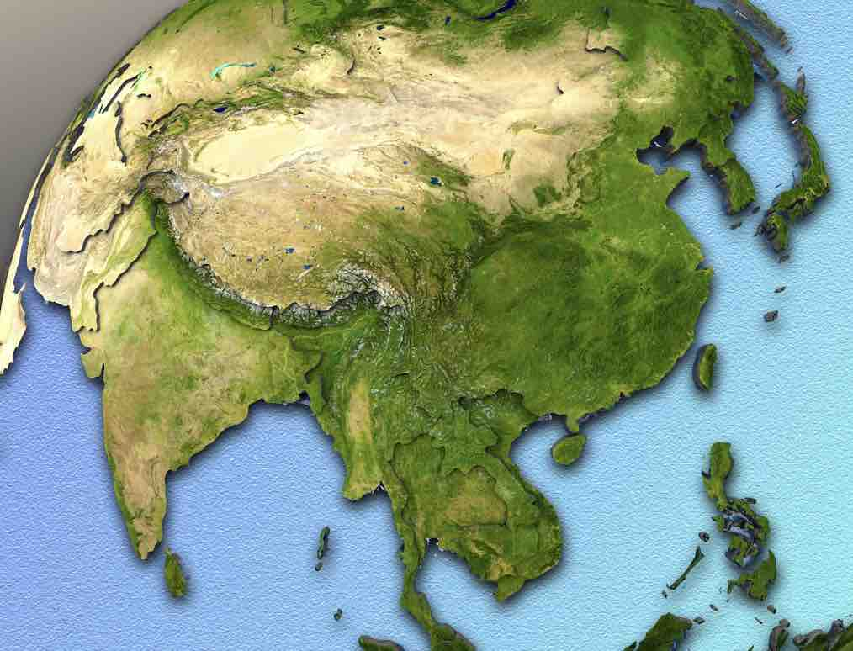
The Spread of Buddhism
Theravada
Mahayana
Vajrayana
c. 1- 100s ce
Mongolia
300s- ce
Afghanistan
1300s
ce
South
Korea
Japan
Tibet
500s- 600s ce
100s bce
- 100 ce
300s- 400s ce ?
Pakistan
600s
ce
Nepal
500s- ce ?
Bhutan
200s
bce
China
c. 1- 100s ce
India
Bangladesh
200s
bce
200s
bce
Myanmar
Vietnam
Laos
Cambodia
c. 100 bce - 400s ce
Philippines
400s- 1400s bce
Thailand
Sri
Lanka
c. 1- 600s ce
Indonesia
Malaysia

Slide 14
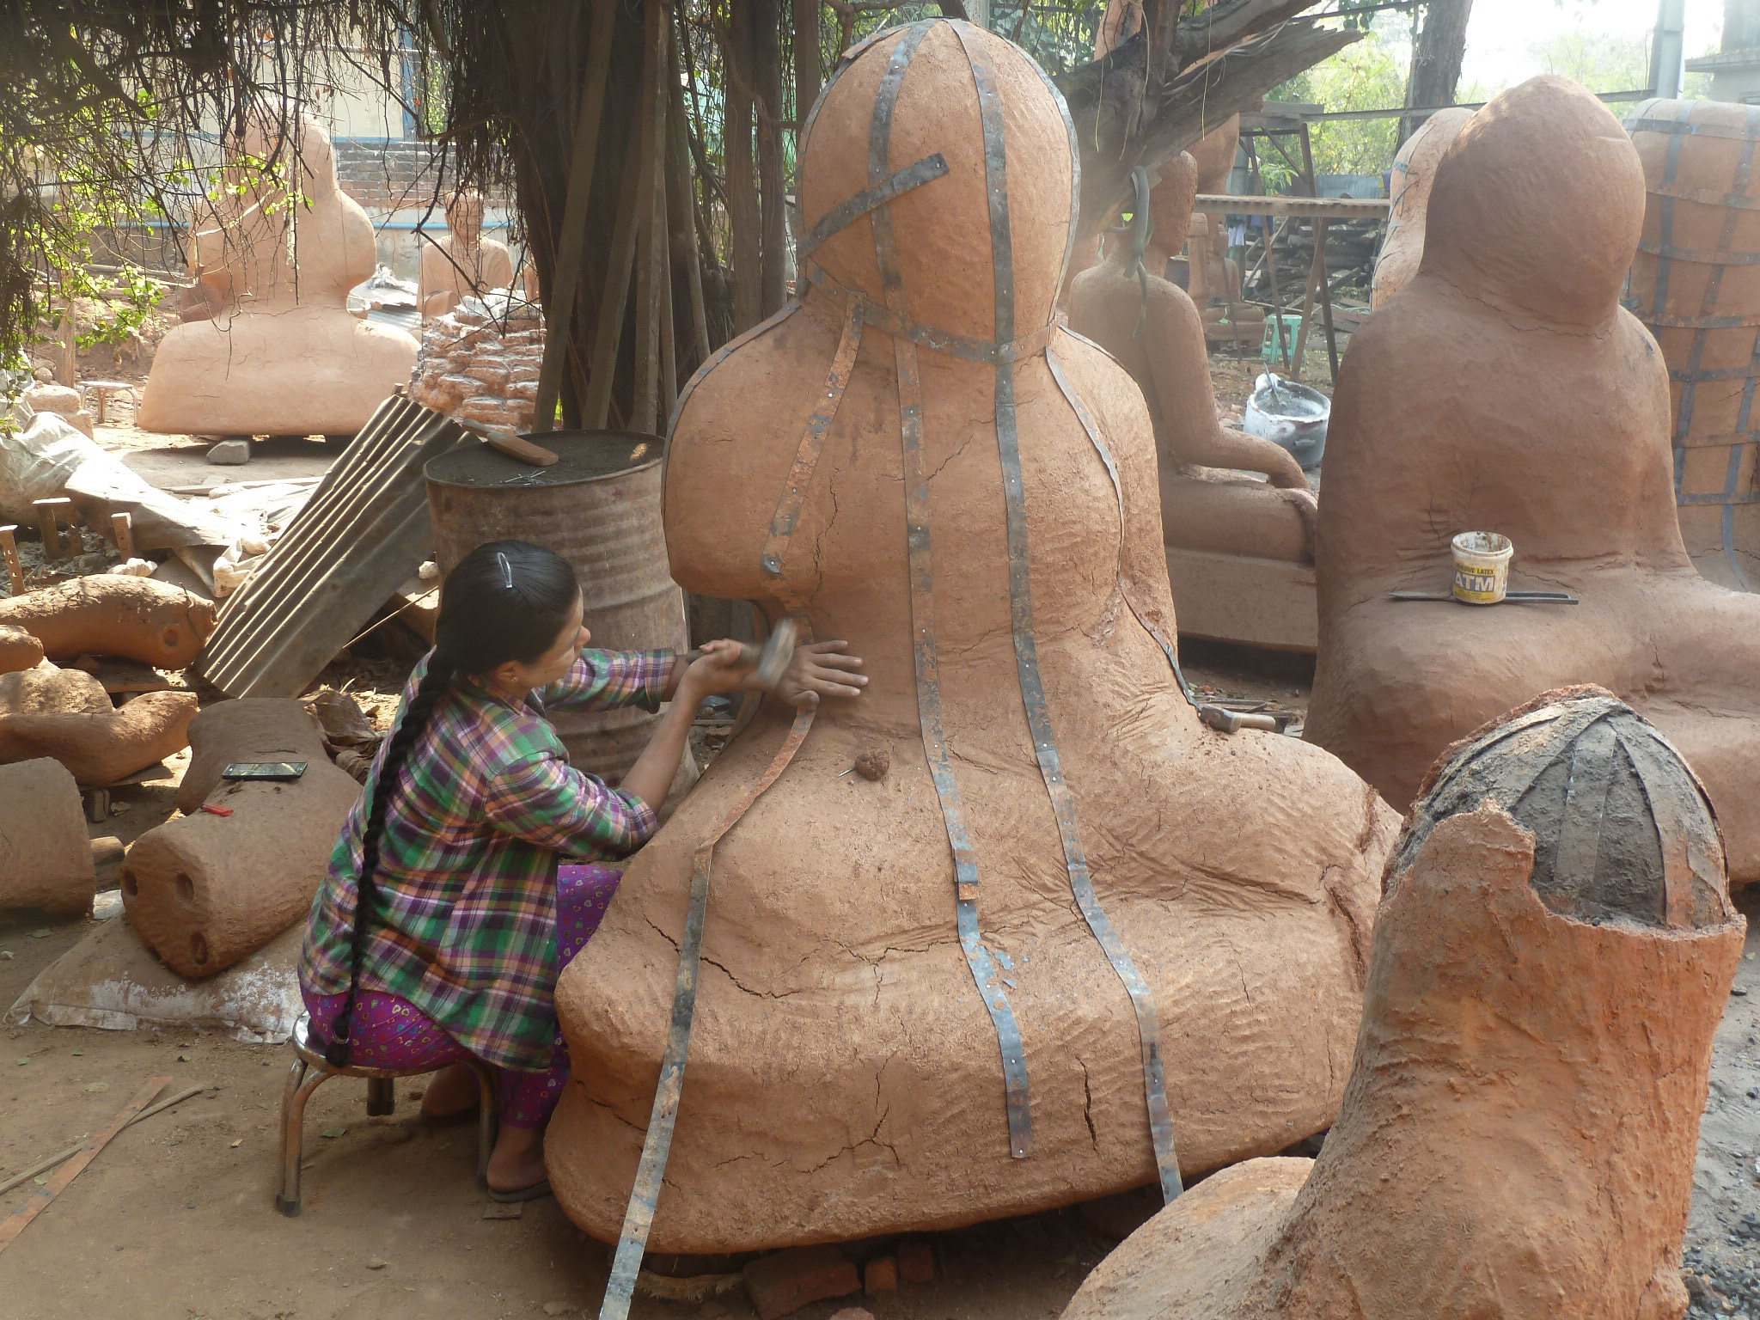
Workshop for Buddha Images

Slide 15
Main Branches of Buddhism
Mayahana
Vajrayana
Theravada

Slide 16
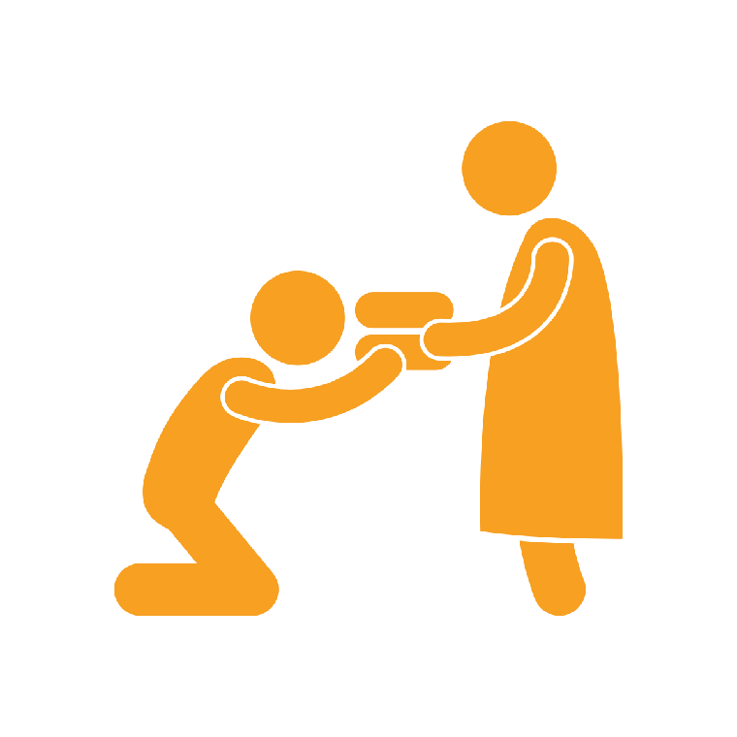
Common Buddhist Symbols
Dharma Chakra
Buddha
images
Stupas
Lotus
flower
Monks /
begging
bowls
Bodhi tree

Slide 17
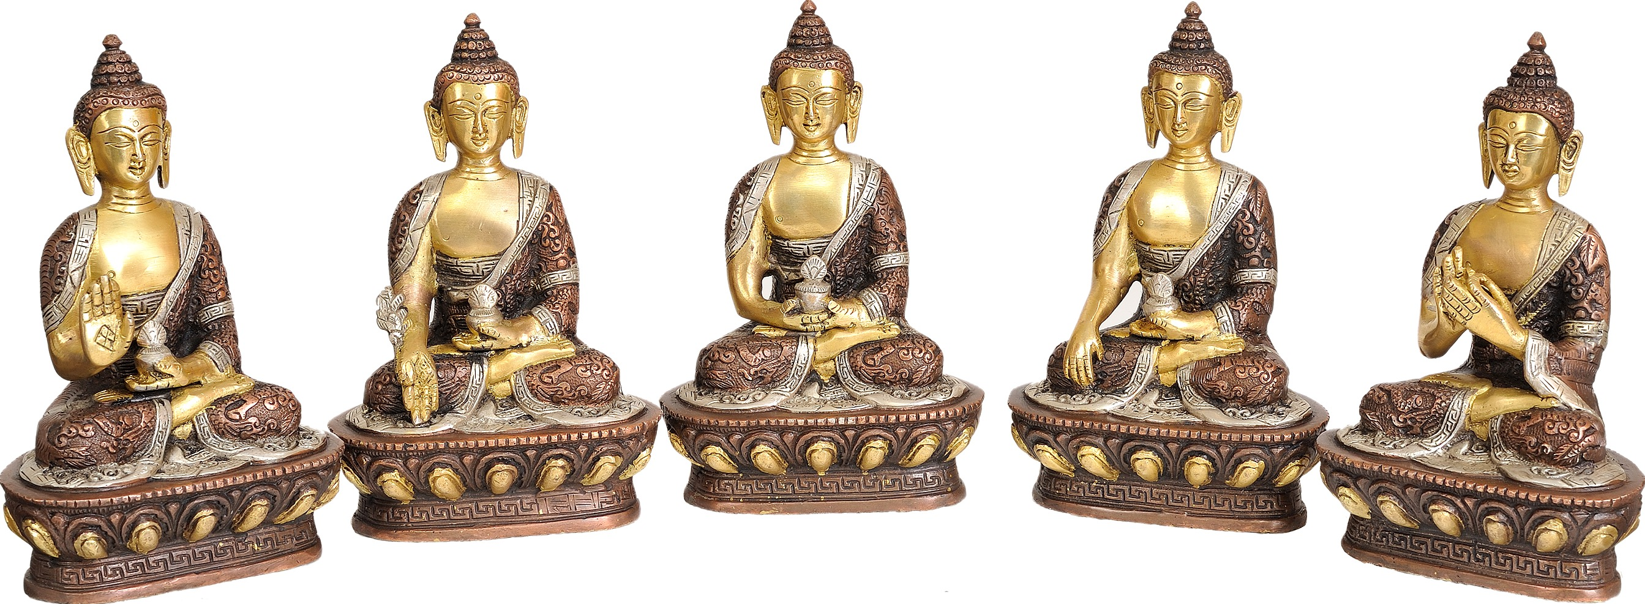
Buddhist Mudras
Abhaya Fear-Not
Varadana Boon-Granting
Dhyana
Meditation
Bhumisparsha Earth-Touching
Dharmachakra Turning the Wheel of Dharma
Image © www.exoticindia.com

Slide 18
Shinto Symbols
Mt. Fuji
Torii
Sun

Slide 19
The Five Vices
Lust
Anger
Greed
Attachment
Ego

Slide 20
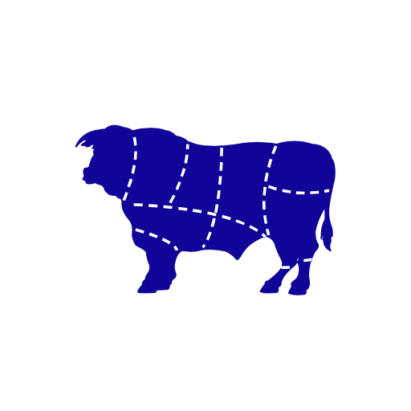
The Four Prohibitions
NO
Cutting Hair
NO
Halal or
Kosher Meat
NO
Adultery
NO
Intoxicants

